Slide 1
Viewing Transformation (2)
디지털 그래픽스 [10주차]
Viewport Transformation

Slide 2
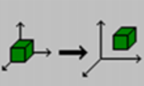
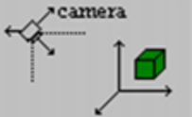
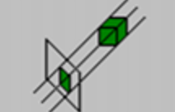
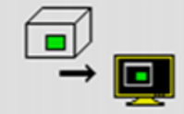
Perspective Transformation
3차원 모델을 2차원 모니터에 디스플레이 하는 과정
Modeling
Transformation
Viewing
Transformation
Projection
Transformation
Viewport
Transformation
3차원 세계에
3D 모델 배치
카메라 기준
3D 모델 배치
3차원 물체를
2차원 면에 투영
윈도우에
2차원 디스플레이
Modeling transform
Viewing transform
Projection transform

Slide 3
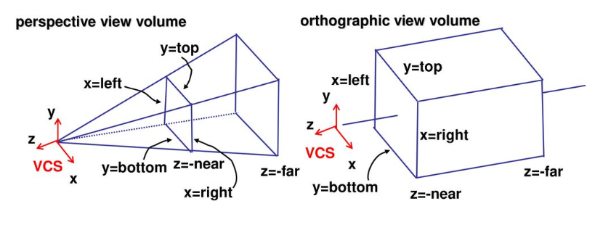
View Volume
Perspective View Volume : 원근감
Orthographic View Volume : 평면도 등에 사용

Slide 4
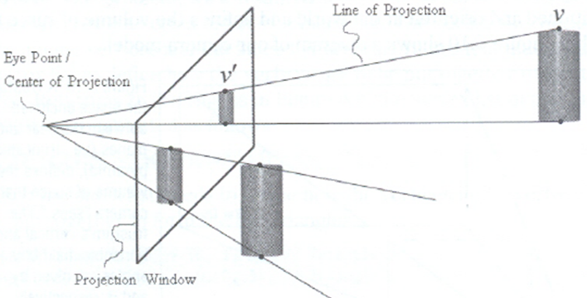
Perspective Illusion
원근감

Slide 5
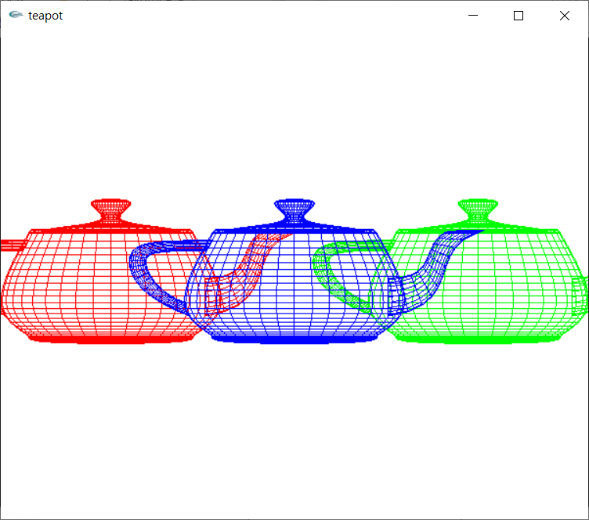
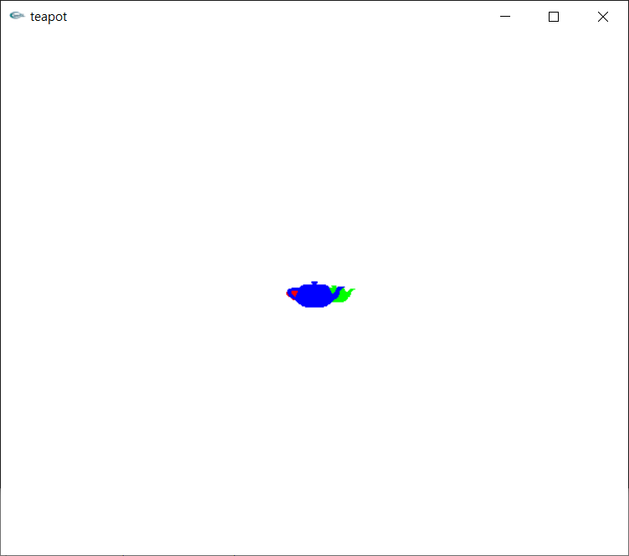
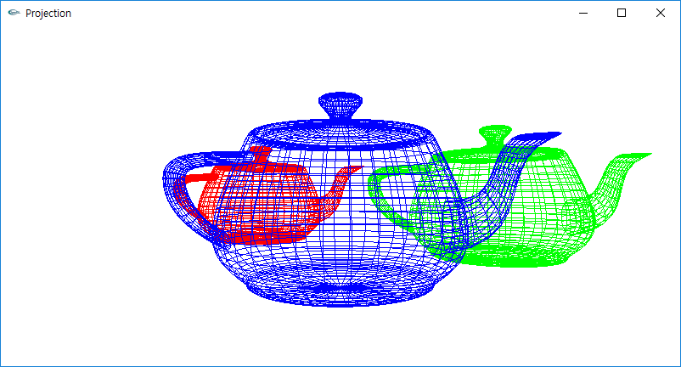
parallel vs. perspective projection
glOrtho(..) vs. glFrustum(..)
glOrtho( -8, 8, -8, 8, 1.5, 30 )
glFrustum( -8, 8, -8, 8, 1.5, 30 )
Z=-10
Z=0
Z=-5
Z=-10
Z=0
Z=-5

Slide 6
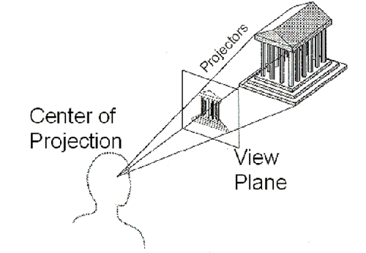
Projection
In Computer Graphics
Map 3D coordinates to 2D coordinates
Based on the camera model

Slide 7
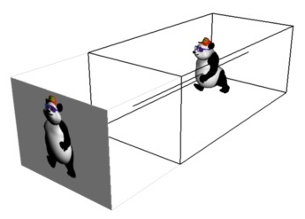
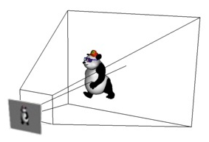
The way of projections
Geometric Projection
Parallel
Perspective

Slide 8
Orthographic View Volume
View Volume parameters
left, right, bottom, top, near, far
top
left
far
far plane
right
bottom
near
near plane

Slide 9
OpenGL Orthographic Projection
glOrtho(..)

Slide 10
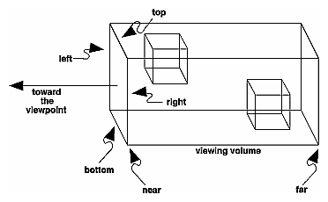

OpenGL: Orthogonal Projection
void glOrtho( GLdouble left, GLdouble right,
GLdouble bottom, GLdouble top,
GLdouble zNear, GLdouble zFar )
left, right, bottom, top : 좌표
zNear, zFar : 거리 ( zNear: camera ~ near plane, zFar: camera ~ far plane)
y
z
zNear = 1
zFar = 3

Slide 11
Orthogonal Projection
glOrtho(-1.0, 1.0, -1.0, 1.0, 1.0, 3.0);
gluLookAt( 0.0, 0.0, 2.0,
0.0, 0.0, 1.0,
0.0, 1.0, 0.0);
void glOrtho( GLdouble left, GLdouble right,
GLdouble bottom, GLdouble top,
GLdouble zNear, GLdouble zFar )
glOrgho( -1.0, 1.0, -1.0, 1.0, 1.0, 3.0);
Look at point는
near plane과
Camera direction과의
접점으로 설정
z=2
z=1
z=0
z=-1
y
z
(0,0,2)
(0,0,1)
(0,0,0)
zNear = 1
zFar = 3

Slide 12
Orthogonal Projection
glOrtho(-1.0, 1.0, -1.0, 1.0, 1.0, 3.0);
gluLookAt( 0.0, 0.0, 0.0,
0.0, 0.0, -1.0,
0.0, 1.0, 0.0);
void glOrtho( GLdouble left, GLdouble right, GLdouble bottom, GLdouble top, GLdouble zNear, GLdouble zFar )
glOrgho( -1.0, 1.0, -1.0, 1.0, 1.0, 3.0);
z=0
z=-1
z=-2
z=-3
y
z
(0,0,0)
(0,0,-1)
(0,0,-2)
zNear = 1
zFar = 3

Slide 13
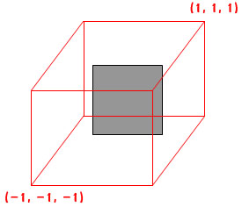
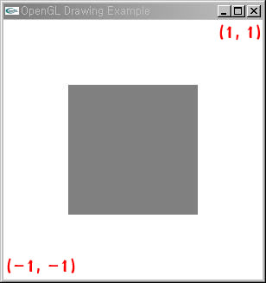
How the view volume works
void glOrtho( GLdouble left, GLdouble right, GLdouble bottom, GLdouble top, GLdouble zNear, GLdouble zFar )
glOrgho( -1.0, 1.0, -1.0, 1.0, 1.0, 3.0);
Rectangle of size 1 at the origin
glOrtho(-1.0, 1.0, -1.0, 1.0, 1.0, 3.0);
3D World
2D Window
Projection
(0.5,0.5,0)
(0,0,0)
(-0.5,-0.5,0)

Slide 14
How the view volume works
Variations of view volume
glOrtho(-1.0, 1.0, -1.0, 1.0, 1.0, 3.0);
3D World
2D Window
Projection
(0.5,0.5,0)
(0,0,0)
(-0.5,-0.5,0)
glOrtho(-0.5, 0.5, -0.5, 0.5, 1.0, 3.0);
(0.5, 0.5, 1)
(0.5,0.5,0)
Projection
(0,0,0)
(-0.5, -0.5, -1)
(-0.5,-0.5,0)

Slide 15
How the view volume works
view volume
glOrtho(-2.0, 2.0, -2.0, 2.0, 1.0, 3.0);
3D world
(2, 2)
(0.5, 0.5)
(-0.5, -0.5)
(-2, -2)

Slide 16
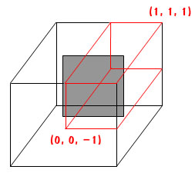
How the view volume works
3D world
(1, 1)
(0.5, 0.5)
(-0.5, -0.5)
(-1, -1)
glOrtho(0.0, 1.0, 0.0, 1.0, 1.0, 3.0);
3D World
2D Window
Projection
(0,0,0)

Slide 17
How the view volume works
view volume
glOrtho(-1.0, 0.0, -1.0, 0.0, 1.0, 3.0);
3D world
(1, 1)
(0.5, 0.5)
(-0.5, -0.5)
(-1, -1)

Slide 18
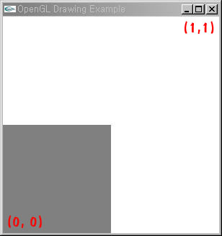

How the view volume works
(0.5, 0.5)
view volume
glOrtho(0.0, 1.0, -1.0, 0.0, 1.0, 3.0);
(-0.5, -0.5)
glOrtho(0.0, 1.0, 0.0, 1.0, -1.0, 1.0);
glOrtho(0.0, 1.0, -1.0, 0.0, 1.0, 3.0);
3D World
2D Window
Projection
(1, 0, 3)
(0, -1, 1)

Slide 19
How the view volume works
view volume
glOrtho(-1.0, 0.0, 0.0, 1.0, 1.0, 3.0);
(0.5, 0.5)
(-0.5, -0.5)

Slide 20
How the view volume works
(0.5, 0.5)
view volume
glOrtho(-1.0, 1.0, -1.0, 0.0, 1.0, 3.0);
(-0.5, -0.5)
glOrtho(0.0, 1.0, 0.0, 1.0, -1.0, 1.0);
glOrtho(-1.0, 1.0, -1.0, 0.0, 1.0, 3.0);
(1, 0, 3)
Projection
(-1, -1, 1)

Slide 21
How the view volume works
view volume
glOrtho(-1.0, 1.0, 0.0, 1.0, 1.0, 3.0);
(0.5, 0.5)
(-0.5, -0.5)

Slide 22
How the view volume works
(0.5, 0.5)
view volume
glOrtho(-2.0, 2.0, -1.0, 0.0, 1.0, 3.0);
(-0.5, -0.5)
glOrtho(0.0, 1.0, 0.0, 1.0, -1.0, 1.0);
glOrtho(-2.0, 2.0, -1.0, 0.0, 1.0, 3.0);
(2, 0, 3)
Projection
(-2, -1, 1)

Slide 23
How the view volume works
view volume
glOrtho(-2.0, 2.0, 0.0, 1.0, 1.0, 3.0);

Slide 24
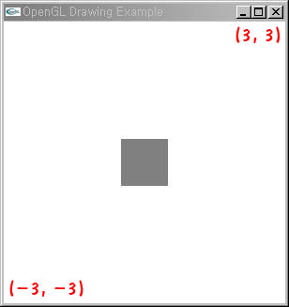
How the view volume works
(0.5, 0.5)
view volume
glOrtho(-3.0, 3.0, -3.0, 3.0, 1.0, 3.0);
(-0.5, -0.5)
(3, 3, 3)
glOrtho(-3.0, 3.0, -3.0, 3.0, 1.0, 3.0);
Projection
(-3, -3, 1)

Slide 25
How the view volume works
view volume
glOrtho(-0.3, 0.3, -0.3, 0.3, 1.0, 3.0);
(0.5, 0.5)
(-0.5, -0.5)

Slide 26
How the view volume works
view volume
glOrtho(-10, 10, -10, 10, 1.0, 3.0);
(10, 10)
(0, 0)
(-10, -10)

Slide 27
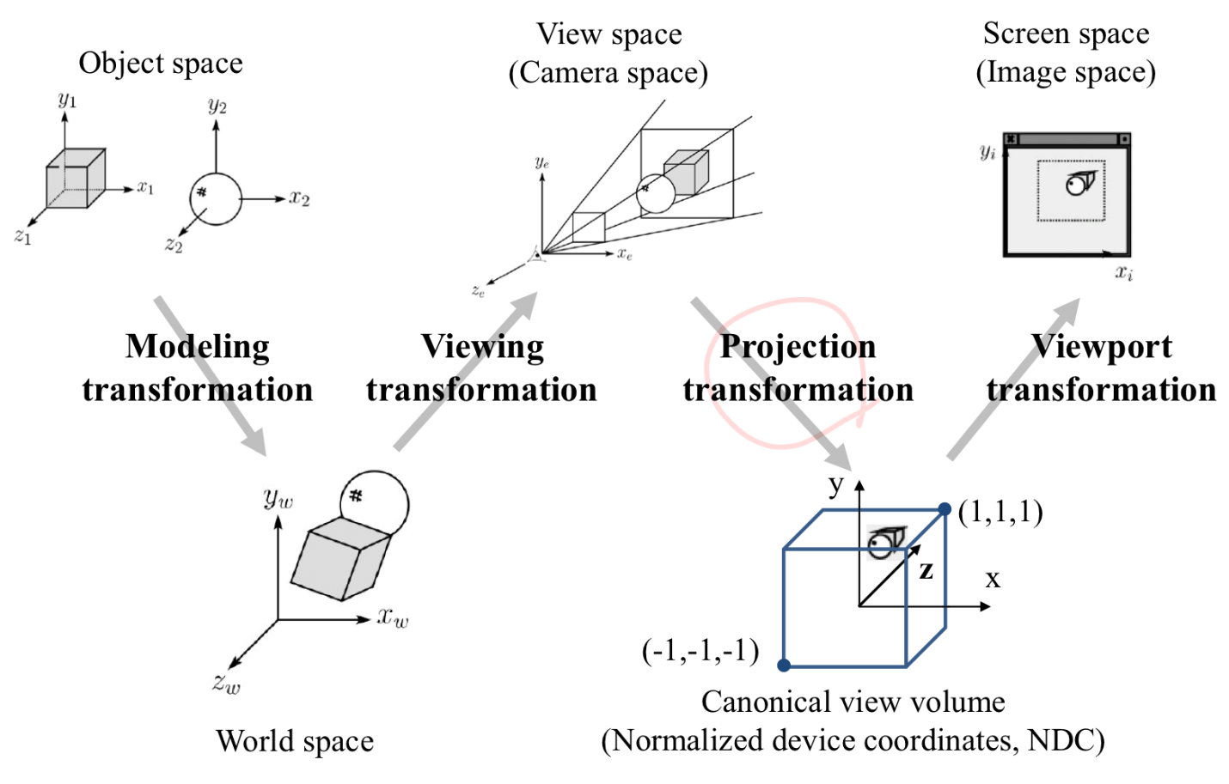
Transformation
Matrix mode
행렬 모드, 행렬 종류
void glMatrixMode(mode)
modeling transform, viewing transform(camera)
projection transform
3D-->2D
glTranslatef(..)
glScalef(..)
glRotatef(..)
gluLookAt(..)
glOrtho(..)

Slide 28
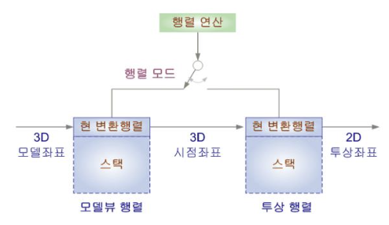
glOrtho()
Matrix mode
행렬 모드, 행렬 종류
void glMatrixMode(mode)
modeling transform, viewing transform(camera)
projection transform
--> GL_MODELVIEW
-->GL_PROJECTION
 | OpenGL f. | Matrix Mode
Modeling Transform | glTranslatef(..) | GL_MODELVIEW
Viewing Transform | gluLookAt(..) | GL_MODELVIEW
Projection Transform | glOrtho(..) | GL_PROJECTION
GL_MODELVIEW
GL_PROJECTION

Slide 29
glOrtho()
Matrix mode
조작하고자 하는 행렬 선택
void glMatrixMode(mode)
GL_MODELVIEW : model transform, viewing transform(camera)
GL_PROJECTION : projection transform
Current Transformation matrix (현 변환 행렬)
glMatrixMode(GL_PROJECTION);
glLoadIdentity();
glOrtho(-1.0, 1.0, -1.0, 1.0, 1.0, 3.0);
glMatrixMode(GL_MODELVIEW);
glLoadIdentity();

Slide 30

glOrtho()
y
y
(1,1)
(0,0,1)
x
z
(0,0,2)
(-1,-1)
#include <iostream>
#include <gl/glut.h>
#include <gl/glu.h>
using namespace std;
void display(void)
{
glClear(GL_COLOR_BUFFER_BIT | GL_DEPTH_BUFFER_BIT);
glLoadIdentity();
gluLookAt(0.0, 0.0, 2.0, // camera pos
0.0, 0.0, 1.0, // lookat point
0.0, 1.0, 0.0); // up vector
glColor3f(1, 1, 1);
glutWireTeapot(0.3);
glFlush();
}
void reshape(int w, int h)
{
glMatrixMode(GL_PROJECTION);
glLoadIdentity();
glOrtho(-1.0, 1.0, -1.0, 1.0, 1.0, 3.0);
glMatrixMode(GL_MODELVIEW);
}
int main(int argc, char** argv)
{
glutInit(&argc, argv);
glutInitDisplayMode(GLUT_RGBA | GLUT_DEPTH | GLUT_SINGLE);
glutCreateWindow("Viewing Transformation");
glClearColor(0.0, 0.0, 0.0, 0.0);
glutReshapeFunc(reshape);
glutDisplayFunc(display);
glutMainLoop();
return 0;
}

Slide 31
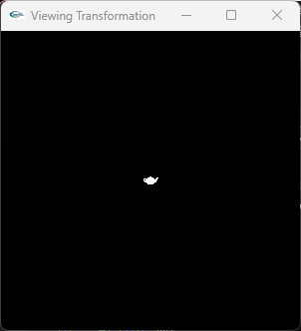
glOrtho()
y
y
(10,10)
(0,0,5)
(0,0,-20)
z
x
(0,0,10)
(-10,-10)
#include <iostream>
#include <gl/glut.h>
#include <gl/glu.h>
using namespace std;
void display(void)
{
glClear(GL_COLOR_BUFFER_BIT | GL_DEPTH_BUFFER_BIT);
glLoadIdentity();
gluLookAt(0.0, 0.0, 10.0,// camera pos
0.0, 0.0, 0.0, // lookat point
0.0, 1.0, 0.0); // up vector
glColor3f(1, 1, 1);
glutWireTeapot(0.3);
glFlush();
}
void reshape(int w, int h)
{
glMatrixMode(GL_PROJECTION);
glLoadIdentity();
glOrtho(-10.0, 10.0, -10.0, 10.0, 5.0, 30.0);
glMatrixMode(GL_MODELVIEW);
}
int main(int argc, char** argv)
{
glutInit(&argc, argv);
glutInitDisplayMode(GLUT_RGBA | GLUT_DEPTH | GLUT_SINGLE);
glutCreateWindow("Viewing Transformation");
glClearColor(0.0, 0.0, 0.0, 0.0);
glutReshapeFunc(reshape);
glutDisplayFunc(display);
glutMainLoop();
return 0;
}

Slide 32

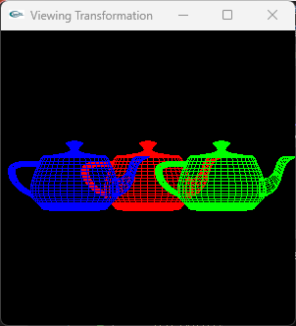
glOrtho()
y
y
(10,10)
(0,0,5)
(0,0,-20)
z
x
(0,0,10)
#include <iostream>
#include <gl/glut.h>
#include <gl/glu.h>
using namespace std;
void display(void)
{
glClear(GL_COLOR_BUFFER_BIT | GL_DEPTH_BUFFER_BIT);
glLoadIdentity();
gluLookAt(0.0, 0.0, 10.0, 0.0, 0.0, 0.0, 0.0, 1.0, 0.0);
glColor3f(1, 0, 0);
glutWireTeapot(3);
glColor3f(0, 1, 0);
glTranslatef(5,0,-5);
glutWireTeapot(3);
glColor3f(0, 0, 1);
glTranslatef(-10,0,-5);
glutWireTeapot(3);
glFlush();
}
(-10,-10)
void reshape(int w, int h)
{
glMatrixMode(GL_PROJECTION);
glLoadIdentity();
glOrtho(-10.0, 10.0, -10.0, 10.0, 5.0, 30.0);
glMatrixMode(GL_MODELVIEW);
}
int main(int argc, char** argv)
{
glutInit(&argc, argv);
glutInitDisplayMode(GLUT_RGBA | GLUT_DEPTH | GLUT_SINGLE);
glutCreateWindow("Viewing Transformation");
glClearColor(0.0, 0.0, 0.0, 0.0);
glutReshapeFunc(reshape);
glutDisplayFunc(display);
glutMainLoop();
return 0;
}

Slide 33
Quiz. Projection & Viewport Transformation
다음은 카메라와 주전자의 위치입니다.
3D world에 카메라와 다음 주전자들을 배치하고 디스플레이하세요. glOrtho() 사용
Camera: (0,0,0)
Red Teapot : (10, 5, 10)
Green Teapot : (0,0,5)
Blue Teapot : (-10, -5, 20)
Window Position : (100, 200)
Window Size: (600, 400)
Viewport: 왼쪽 위, half width, half height
[advanced] glFrustum(..) 또는 gluPerspective(..) 사용
퀴즈제출 : code 2개, 결과 이미지 캡쳐 2개

Slide 34
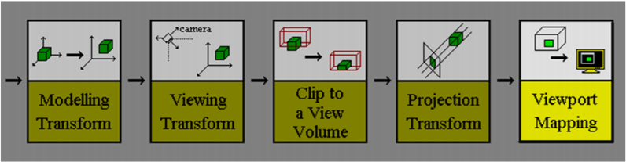
Viewing Transformation
3차원 모델을 2차원 모니터에 디스플레이 하는 과정
3D 모델을
3차원 세계에 배치
카메라 배치
카메라 기준
카메라
View volume
3차원 물체를
2차원 면에 투영
윈도우 내부
일부분에 매핑

Slide 35
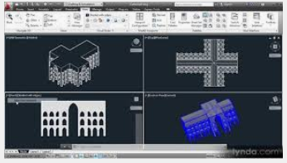
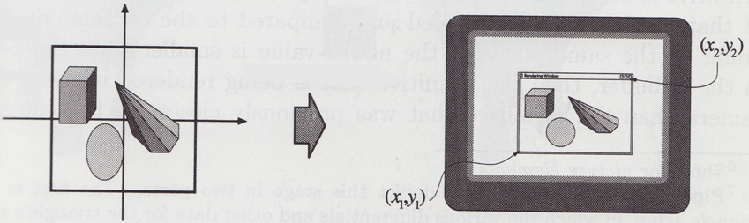
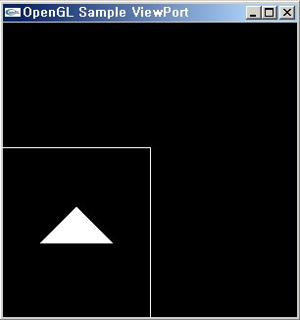
Viewport Transformation
Translates the viewing coordinates
into the device coordinates
View volume vs. viewport
Where we want to see vs. whe
re we want to display

Slide 36
Viewport Transformation
void glViewport(GLint x, GLint y, GLsizei width, GLsizei height)
left-low corner coordinate (x, y)
viewport size (width, height)
Example
// initialize the size of a window
glutInitWindowSize(200, 200);
// sets the position and size of a viewport
glViewport(0, 0, 100, 100); // 기준: left lower corner
Window size = 200
window
size = 100
viewport
Window size = 200
(0, 0)
size = 100

Slide 37
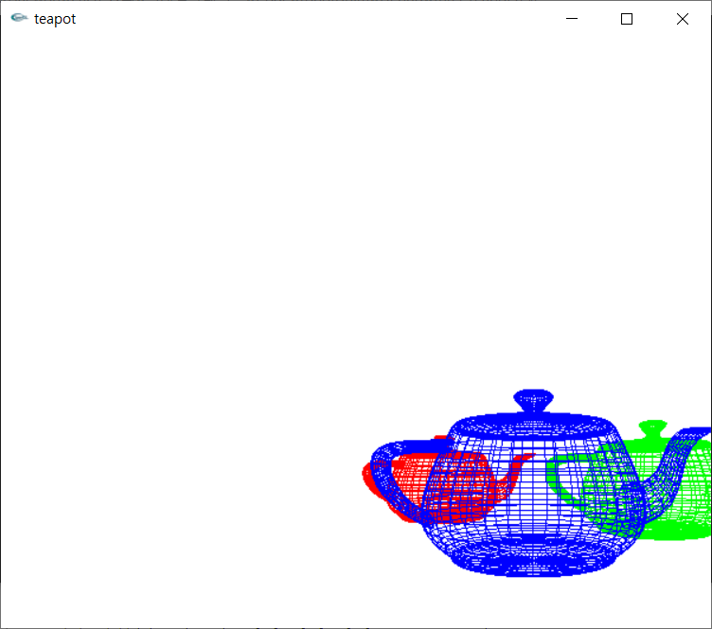
glViewport()
glViewport(GLint x, GLint y, GLsizei width, GLsizei height)
(0,0)
Device : PC monitor, phone
Window
origin
위치 : reshape()
(100,100)
#define WIDTH 800
#define HEIGHT 600
void init()
{
glutInitWindowPosition(100, 100);
glutInitWindowSize(WIDTH, HEIGHT);
}
Window
(3)
600
(2)
(4)
OpenGL
origin
(0,0)
800
void reshape(int w, int h)
{
(1) glViewport(0, 0, w, h);
(2) glViewport(0, 0, w/2, h/2);
(3) glViewport(w/2, h/2, w/2, h/2);
(4) glViewport(w/2, 0, w/2, h/2);
}
glutInitWindowPosition(x,y) : MS windows 원점 기준 upper left
glViewport(x, y, w, h) : Windows 내에서 lower left 원점 기준

Slide 38
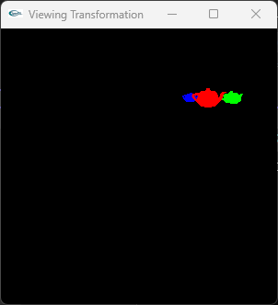
glViewport()
위치 : reshape()
void reshape(int w, int h) // window width, height 파라메터 전달
{
glViewport(w/2, h/2, w/2, h/2);
glMatrixMode(GL_PROJECTION);
glLoadIdentity();
glFrustum(-10.0, 10.0, -10.0, 10.0, 5.0, 30.0);
glMatrixMode(GL_MODELVIEW);
}

Slide 39
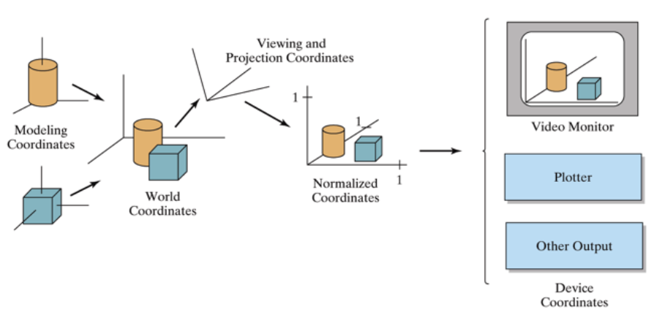
summary: Viewing Pipeline

Slide 40
Viewing Transformation
Thank you !
glOrtho
glFrustum
gluPerspective

